Slide 1
Chapter 3: Cascading Style Sheets (CSS)

Slide 2
What students will learn
Why CSS is used with HTML
CSS rules, selectors, properties, and values
Type, universal, class, and ID selectors
span and div elements
How CSS rules cascade and which rule wins
Style attribute, style element, and external CSS files
Colors, fonts, text, borders, padding, and margins
Element box and common CSS length units
How the chapter combines these ideas in a case study
Web Programming with HTML5, CSS, and JavaScript — Chapter 3

Slide 3
3.1–3.2 CSS: Content vs. Appearance
HTML describes the content of a web page.
CSS describes how that content looks.
CSS can control color, text, fonts, spacing, borders, and more.
Keeping CSS separate from HTML makes changes easier.
Simple idea: HTML = what is on the page; CSS = how it looks.
Web Programming with HTML5, CSS, and JavaScript — Chapter 3

Slide 4
3.3 CSS Rules
A CSS rule tells the browser how selected HTML elements should look.
A selector tells the browser which elements to match.
A property tells what part of the appearance to change.
A value tells the browser what setting to use.
hr {width: 50%;}
Here: hr is the selector, width is the property, and 50% is the value.
Web Programming with HTML5, CSS, and JavaScript — Chapter 3

Slide 5
Type Selector and Universal Selector
Type selector: uses an HTML element name, such as hr or p.
Universal selector: uses * and matches every element.
Use a comma-separated list when the same rule should apply to several element types.
hr {width: 50%;}
* {text-align: center;}
h2, p {font-style: italic; color: blue;}
Web Programming with HTML5, CSS, and JavaScript — Chapter 3

Slide 6
3.4 Example: Tree Poem
The book's Tree Poem example uses three rules.
All text is centered with the universal selector.
The horizontal line is made 50% of its container width.
The heading and paragraph are italic and blue.
<style>
* {text-align: center;}
hr {width: 50%;}
h2, p {font-style: italic; color: blue;}
</style>
Teaching point: one CSS rule can format more than one element type.
Web Programming with HTML5, CSS, and JavaScript — Chapter 3

Slide 7
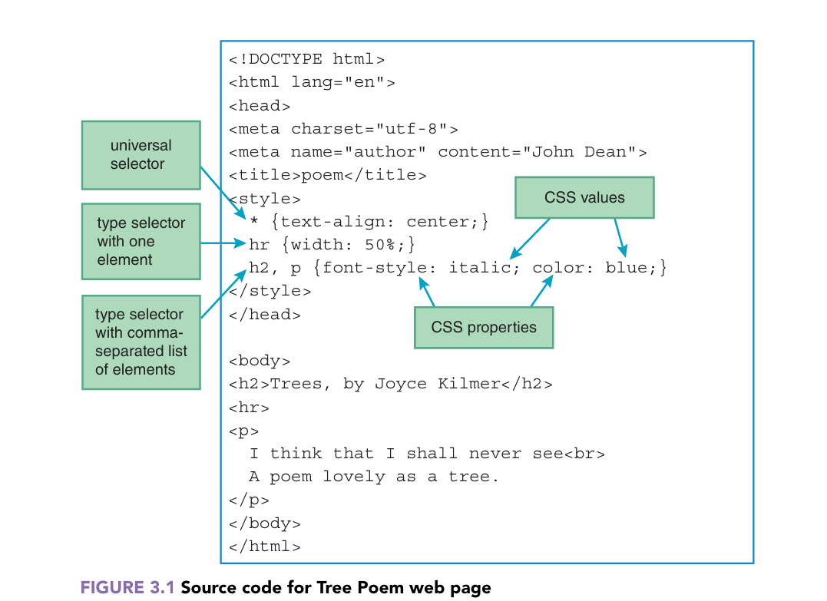
3.4 Example: Tree Poem
Teaching point: one CSS rule can format more than one element type.
Web Programming with HTML5, CSS, and JavaScript — Chapter 3

Slide 8
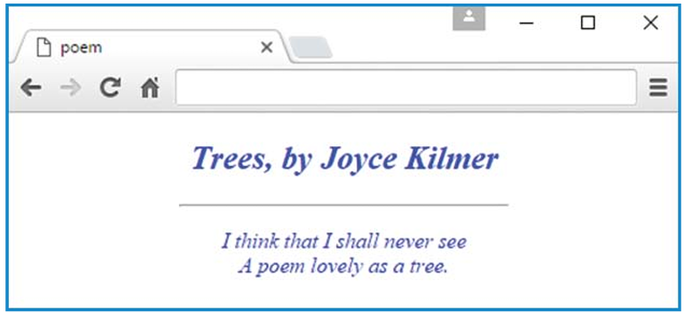
3.4 Example: Tree Poem
Web Programming with HTML5, CSS, and JavaScript — Chapter 3

Slide 9
3.5 CSS Syntax and Style
Put the style element in the head section.
Short rule: selector {property: value;}
Put a semicolon after each property-value pair.
Use a comma and a space between multiple selectors.
For longer rules, put each property on its own line.
Following a common style makes code easier to read and maintain.
p {
color: blue;
text-align: center;
}
Web Programming with HTML5, CSS, and JavaScript — Chapter 3

Slide 10
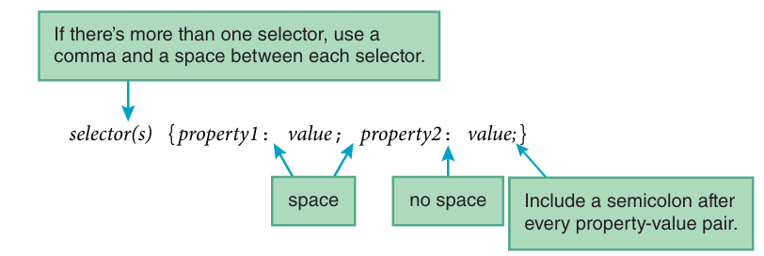
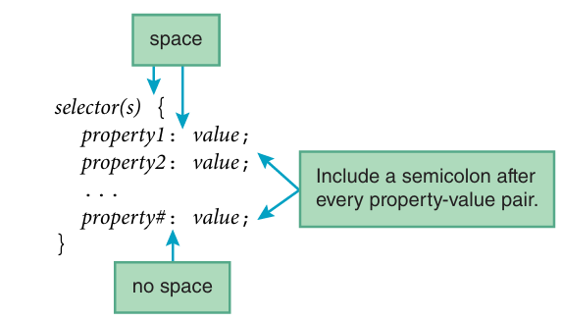
3.5 CSS Syntax and Style
Web Programming with HTML5, CSS, and JavaScript — Chapter 3

Slide 11
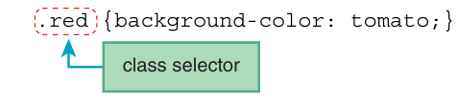
3.6 Class Selectors
A class selector starts with a dot: .class-name
It matches elements whose class attribute has that value.
A class value does not have to be unique.
Choose a class name that describes the purpose.
.red {background-color: tomato;}
<q class="red">A quote...</q>
Web Programming with HTML5, CSS, and JavaScript — Chapter 3

Slide 12
3.6 Class Selectors
With a Class selector we can have more than one class separated by commas sharing one CSS Rule
Web Programming with HTML5, CSS, and JavaScript — Chapter 3

Slide 13
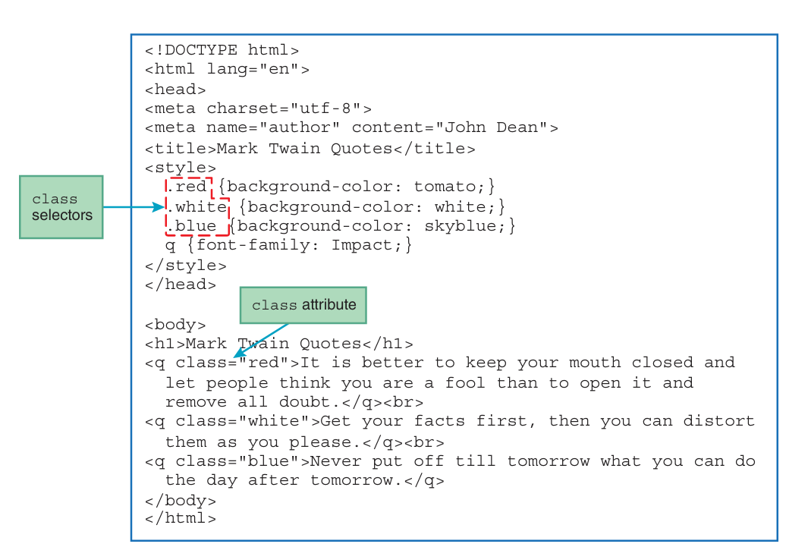
3.6 Class Selectors
Web Programming with HTML5, CSS, and JavaScript — Chapter 3

Slide 14
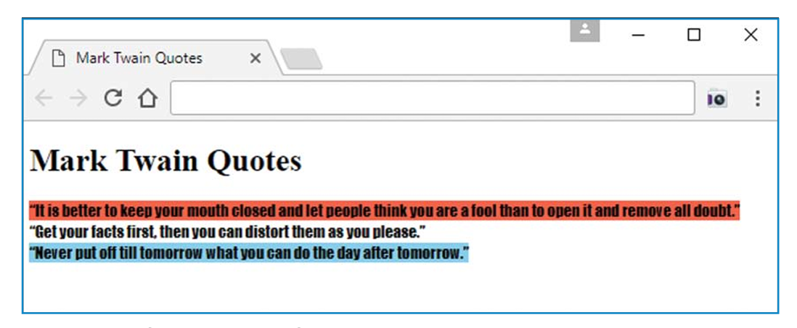
3.6 Class Selectors
Web Programming with HTML5, CSS, and JavaScript — Chapter 3

Slide 15
Class Selector with Element Prefix
q.blue matches only q elements whose class is blue.
h1.blue matches only h1 elements whose class is blue.
This is more specific than simply using .blue.
It can make CSS easier to maintain when different element types need different styles.
q.blue {background-color: skyblue;}
h1.blue {color: blue;}
Web Programming with HTML5, CSS, and JavaScript — Chapter 3

Slide 16
Class Selectors with * prefixes
you can preface a class selector with an *
is the universal selector
it matches all elements
what would the following CSS rule do?
*.big-warning {font-size: x-large; color: red;}
Web Programming with HTML5, CSS, and JavaScript — Chapter 3

Slide 17
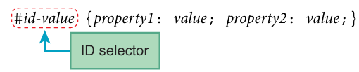
3.7 ID Selectors
An ID selector starts with #.
It matches an element through its id attribute.
An id value must be unique within a web page.
ID selectors are useful when exactly one element should be targeted.
#lizards-lounge {color: green;}
<h3 id="lizards-lounge">Lizards Lounge</h3>
Web Programming with HTML5, CSS, and JavaScript — Chapter 3

Slide 18
Class vs. ID
Class: can be used by many elements.
ID: should identify one unique element on the page.
Class selector uses .
ID selector uses #.
.warning {color: red;}
#main-heading {color: green;}
Web Programming with HTML5, CSS, and JavaScript — Chapter 3

Slide 19
CSS Combinators
A combinator is something that defines the relationship between two or more selectors.
A CSS selector can contain more than one selector.
Between the selectors, we can include a combinator, to create a more specific selection.
There are four different combinators in CSS:
Descendant combinator (space)
Child combinator (>)
Next sibling combinator (+)
Subsequent-sibling combinator (~)
.warning {color: red;}
#main-heading {color: green;}
Web Programming with HTML5, CSS, and JavaScript — Chapter 3

Slide 20


CSS Combinators
Descendant Combinators
The descendant combinator matches all elements that are descendants (children, grandchildren, etc.) of a specified element.
selects all <p> elements inside <div> elements
Child Combinator (>)
The child combinator selects all elements that are direct children of a specified element.
selects all <p> elements that are direct children of <div>
Web Programming with HTML5, CSS, and JavaScript — Chapter 3

Slide 21

CSS Combinators
The next sibling combinator is used to select an element that is directly after a specific element.
Sibling elements must have the same parent element.
selects the first <p> element that immediately follows a <div>, and share the same parent
Web Programming with HTML5, CSS, and JavaScript — Chapter 3

Slide 22


CSS-Pseudo classes
A pseudo-class is used to define a special state of an element.
For example, it can be used to:
Style an element when a user mouse over it
Style visited and unvisited links differently
Style an element when it gets focus
Pseudo-classes are always denoted by a single colon (:) followed by the pseudo-class name:
.submit-btn:hover {
background-color: aquamarine;
}
Web Programming with HTML5, CSS, and JavaScript — Chapter 3

Slide 23

CSS-Pseudo classes
A pseudo-class is used to define a special state of an element.
For example, it can be used to:
Style an element when a user mouse over it
Style visited and unvisited links differently
Style an element when it gets focus
Pseudo-classes are always denoted by a single colon (:) followed by the pseudo-class name:
.submit-btn:hover {
background-color: aquamarine;
}
Web Programming with HTML5, CSS, and JavaScript — Chapter 3

Slide 24

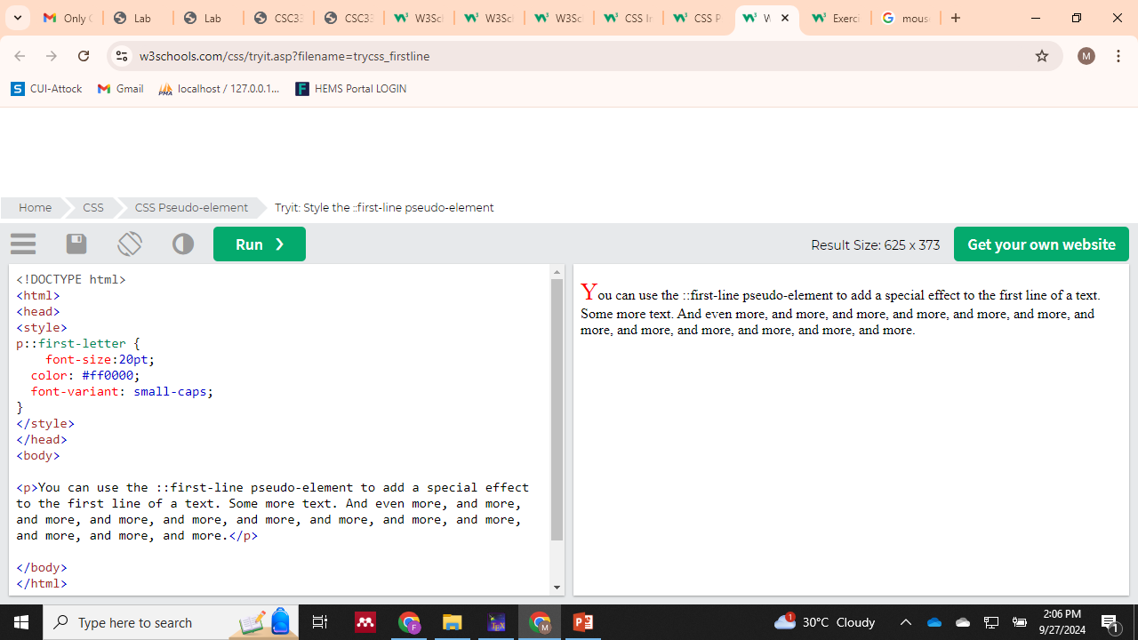
Pseudo-Elements
A CSS pseudo-element is used to style specified parts of an element.
For example, it can be used to:
Style the first letter, or line, of an element
Insert content before, or after, the content of an element
Pseudo-elements are denoted by a double colon (::) followed by the pseudo-element name:
p::first-letter {
font-size:20pt;
color: #ff0000;
font-variant: small-caps;
}
Web Programming with HTML5, CSS, and JavaScript — Chapter 3

Slide 25
3.8 span and div
Use span when the styled text is inside surrounding text.
Use div when the content should act like a block.
span and div are generic elements; by themselves they do not add special meaning.
They are useful as containers for CSS.
<div class="orange">Text and more text...</div>
Price: <span class="white orange-background">$10</span>
Web Programming with HTML5, CSS, and JavaScript — Chapter 3

Slide 26
3.9 Cascading
CSS can have rules in different places.
When rules conflict, the browser uses the rule with higher priority.
More specific rules can override more general rules.
The chapter presents these places from highest to lowest priority:
1. style attribute
2. style element
3. external CSS file
4. user browser settings
5. browser default settings
Web Programming with HTML5, CSS, and JavaScript — Chapter 3

Slide 27
3.10 style Attribute and style Element
style attribute puts CSS directly on one HTML element.
It has the highest priority in the chapter's list.
The book advises avoiding it when possible because it mixes presentation with content.
The style element holds rules for the page and is normally placed in head.
<h2 style="text-decoration:underline;">Welcome!</h2>
Use a style element or external CSS when the same formatting is needed in many places.
Web Programming with HTML5, CSS, and JavaScript — Chapter 3

Slide 28
3.11 External CSS Files
Put CSS rules in a separate file ending in .css.
Connect the HTML page to that file with link.
This keeps large HTML files easier to understand.
One external CSS file can provide common styles for several pages.
<link rel="stylesheet" href="pumpkinPatch.css">
Web Programming with HTML5, CSS, and JavaScript — Chapter 3

Slide 29
External CSS Example
The Pumpkin Patch example moves the same rules out of the HTML file.
The HTML head contains the link element.
The CSS file contains only CSS rules and comments.
/* John Dean */
.orange {color: darkorange;}
.white {color: white;}
.black {color: black;}
.orange-background {background-color: orange;}
Web Programming with HTML5, CSS, and JavaScript — Chapter 3

